Slide 1
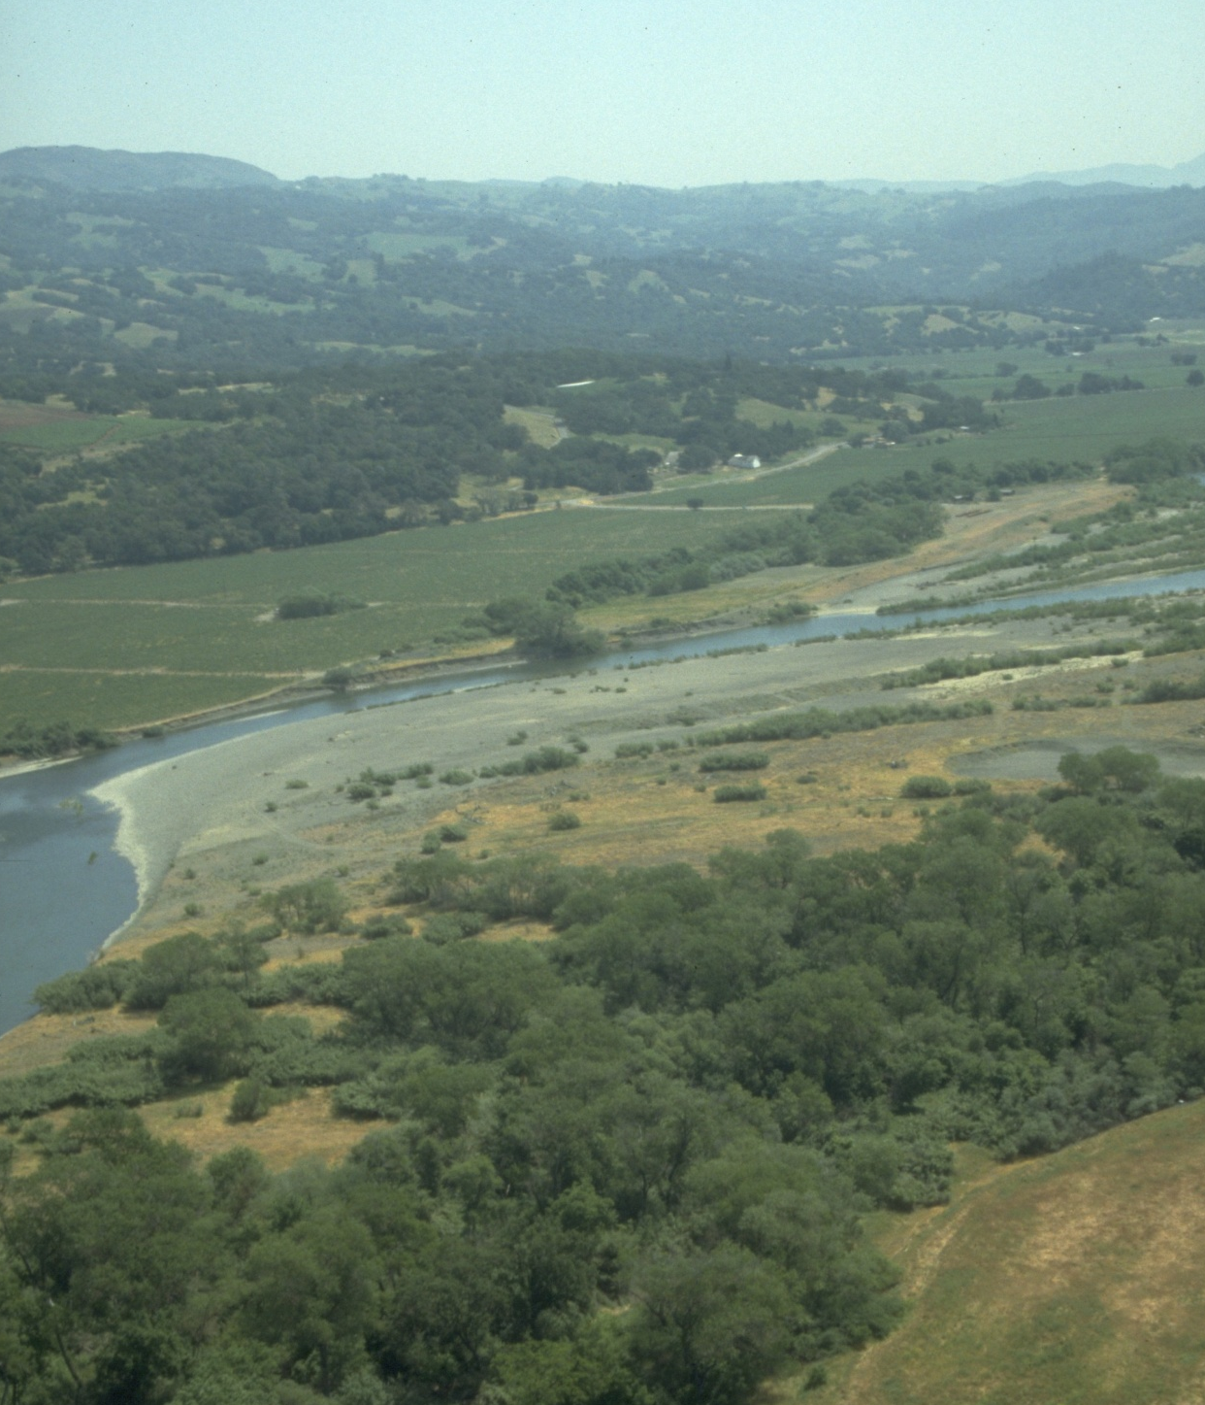
Russian River Independent Science Review Panel
Conceptual Model of Watershed Hydrology, Surface Water and Groundwater Interactions and Stream Ecology for the Russian River Watershed

Slide 2
ISRP TASKS
Assemble and review existing data sources for the entire Russian River watershed.
Identify major data gaps
Evaluate monitoring methods, protocols, Quality Assurance/Quality Control (QA/QC) measures, and recommend standards
Formulate a “conceptual model” of the physical processes of surface and groundwater flow for a series of eight subareas in the watershed. The model answers the question:
“How do surface water and groundwater interact to produce stream flow in creek and river channels and how does this interaction vary spatially in fish-bearing tributary streams?”
Prepare a report describing the watershed and conceptual model, summarizing data sources and data gaps, and recommending needed studies, needed monitoring and monitoring protocols. Submit report for peer review and address/incorporate peer review comments

Slide 3
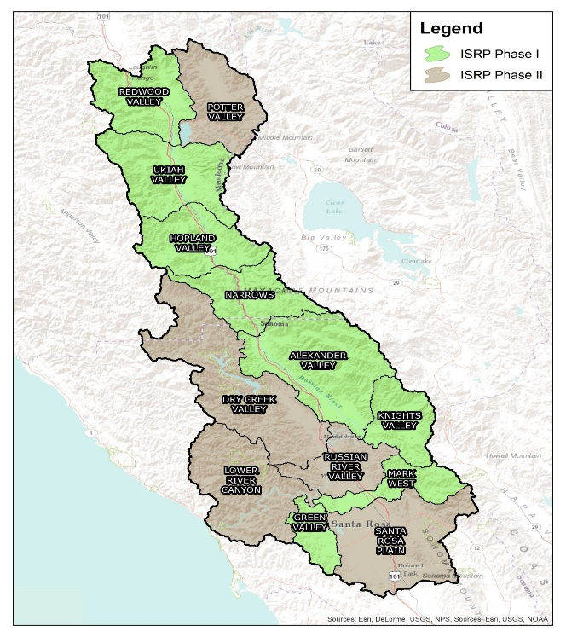
LIMITATIONS OF WHAT WAS REVIEWED
The ISRP evaluated the entire watershed generally but only a portion in great detail.
The focus of this report is stream flow processes, salmonid habitats and water uses.
This report chronicles land use changes and some of the associated water quality effects, but water quality issues were not fully evaluated.
Conditions for the watershed assumed existing water infrastructure and operations and current land use. Land use changes in the watershed are described; however, policy and regulation of land uses are not discussed thoroughly.
Fish species other than salmonids as well as other wildlife and aquatic species are not discussed thoroughly.
Reports and data completed through 2015 are included; more recent reports could not be included.

Slide 4
FUNDING AND MEMBER SELECTION
Funded in 2012 by a group of local water suppliers (Sonoma County Water Agency and the Russian River Mendocino County Flood Control and Water Conservation District), agricultural groups (Russian River Water Conservation Council), and watershed organizations (California Land Stewardship Institute) and growers in Sonoma and Mendocino Counties.
Over 16 applications for the panel were reviewed by representatives from the:
Sonoma County Water Agency,
Russian River Mendocino County Flood Control and Water Conservation District,
Russian River Water Conservation Council the
National Marine Fisheries Service
Two representatives of the agricultural communities of Sonoma County and Mendocino County
Dr. Kondolf, chair of the ISRP.
The selection panel selected nine members to serve on the ISRP, representing scientific expertise in geology, hydrology, groundwater, aquatic ecology, fish biology and resource economics. The selection panel also selected four peer reviewers.
Each ISRP member passed a conflict of interest review similar to that used by the National Science Foundation.

Slide 5
MEMBERS OF THE INDEPENDENT SCIENCE REVIEW PANEL
Dr. Matt Kondolf, Professor of Environmental Planning at U.C. Berkeley.
Dr. Richard Adams, Professor Emeritus of Agricultural and Resource Economics
Dr. John Bredehoeft, consulting Hydrogeologist.
Dr. James Constantz, retired Research Hydrologist.
Dr. Matthew Cover, Associate Professor of Ecology at C.S.U. Stanislaus.
Mr. Christopher Farrar retired U.S. Geological Survey Hydrologist.
Dr. Michael Marchetti, Professor of Ecology at St. Mary’s College of California.
Dr. Vincent Resh, Professor Emeritus of Entomology at U.C. Berkeley.
Dr. F. Douglas Shields, Jr., Consulting Hydraulic Engineer
PEER REVIEWERS
Dr. Alison O’Dowd, Associate Professor, Humboldt State University
Dr. Hubert Morel-Seytoux, Professor Emeritus, Colorado State University
Dr. Wade Martin, Professor, California State University Long Beach
Dr. Jason Gurdak, Associate Professor, San Francisco State University

Slide 6
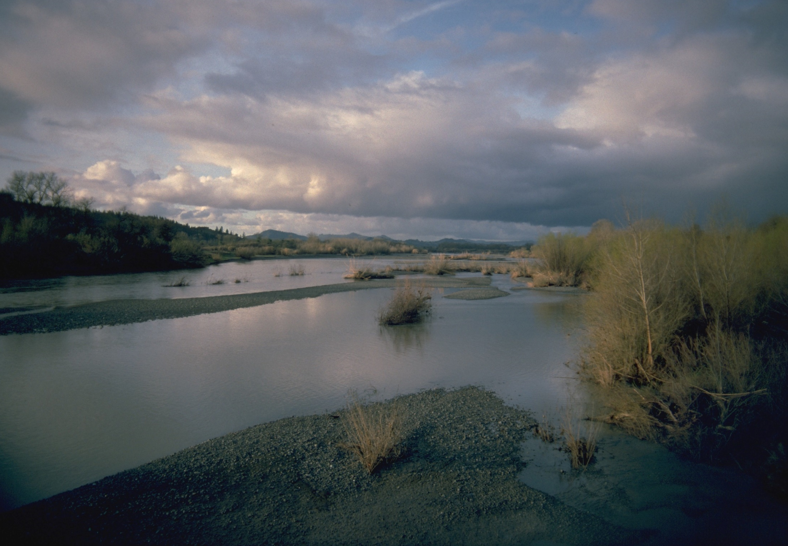
Overview and History of the Russian River Watershed

Slide 7
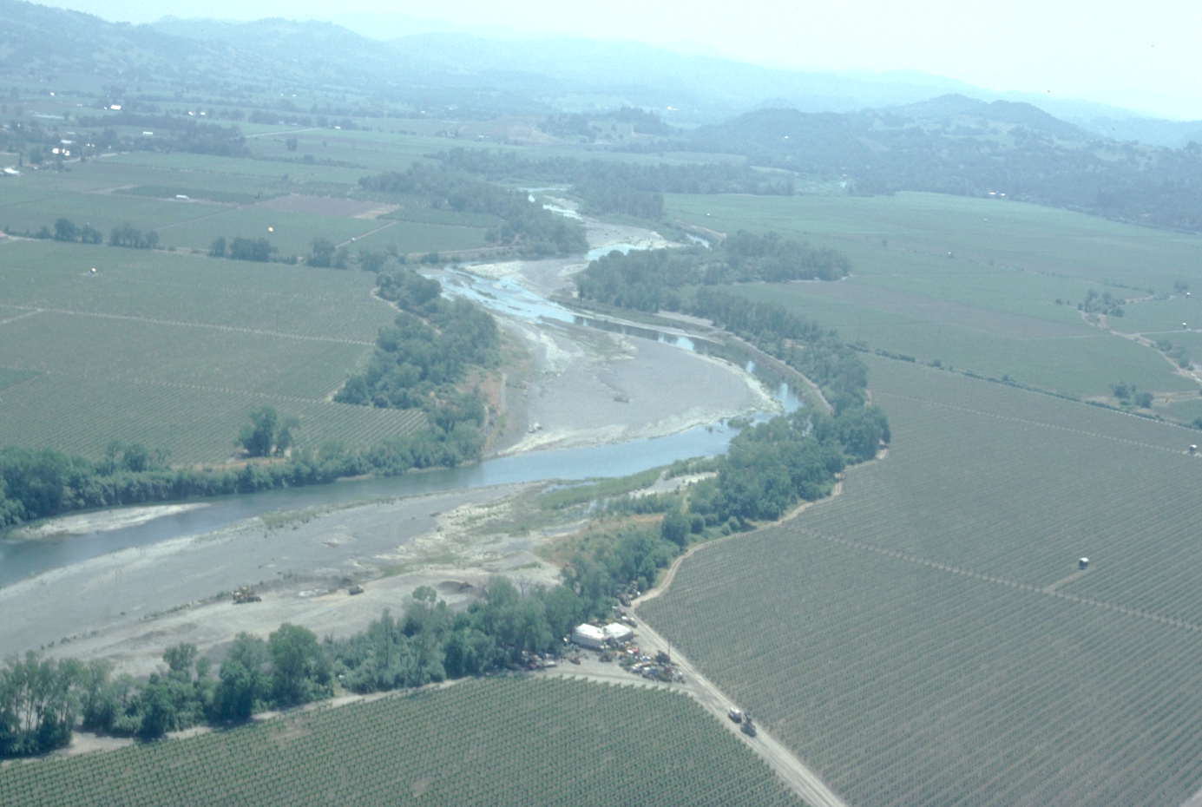
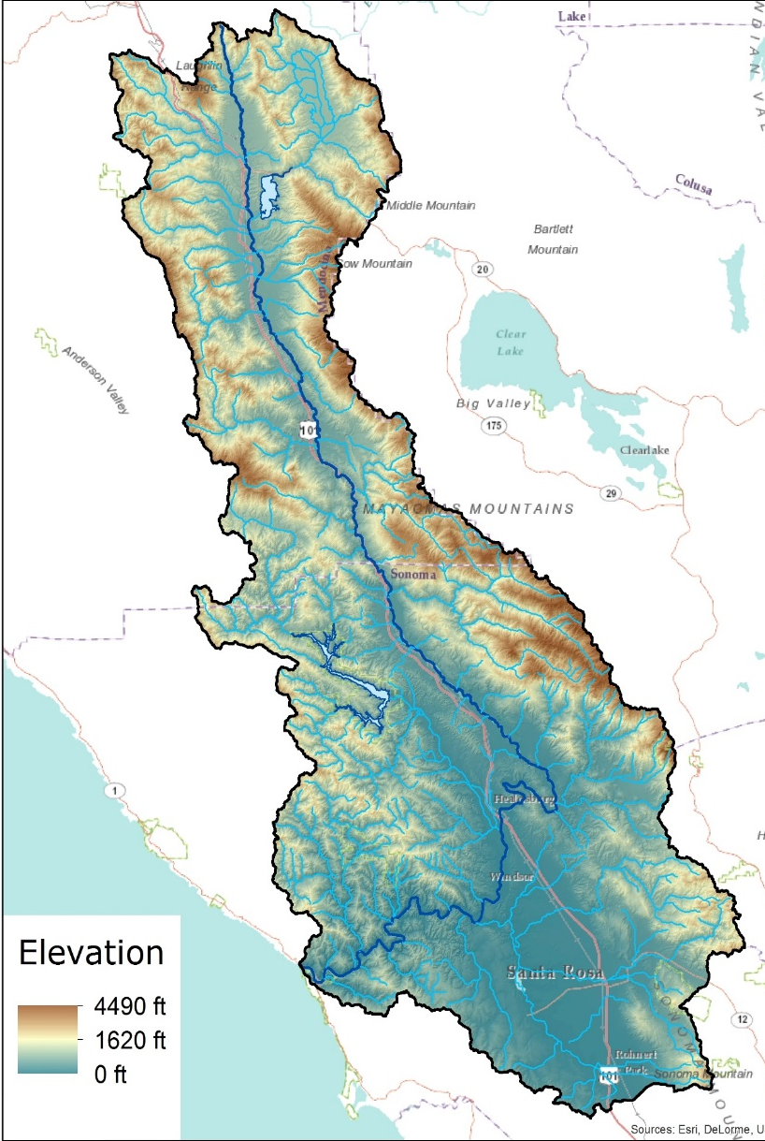
Russian River watershed is one million acres. Unlike most north coast rivers it has a series of alluvial river valleys – Redwood, Ukiah, Hopland, Alexander and Russian River Valley. Mountains border the sides of each valley.

Slide 8
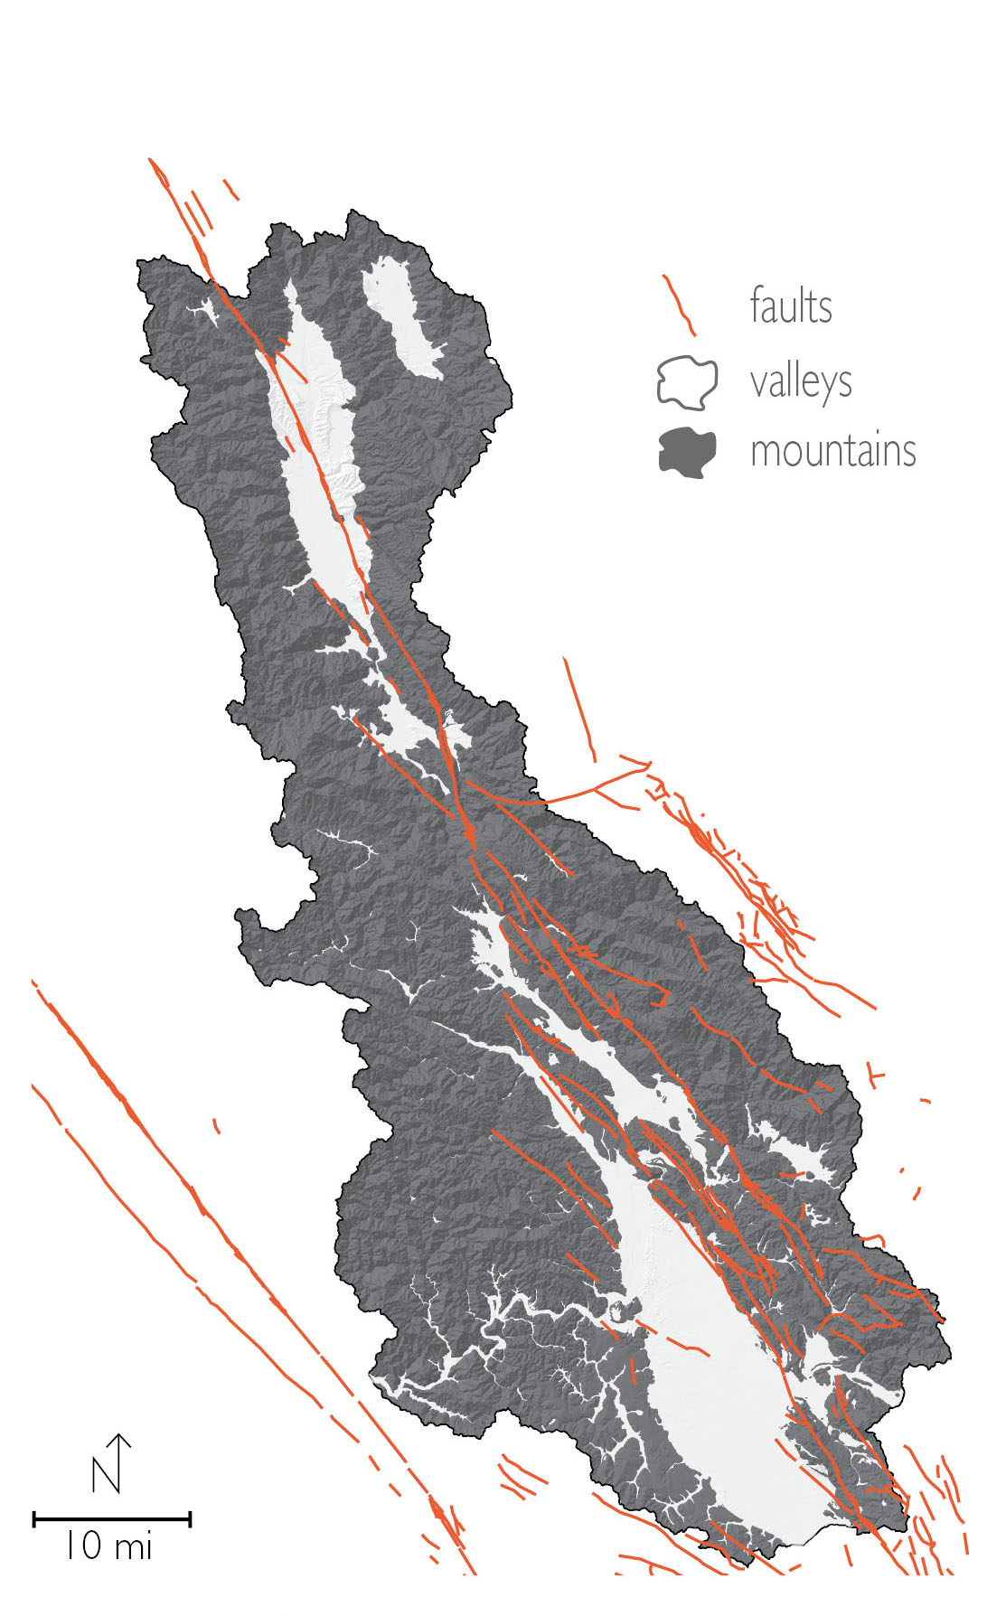
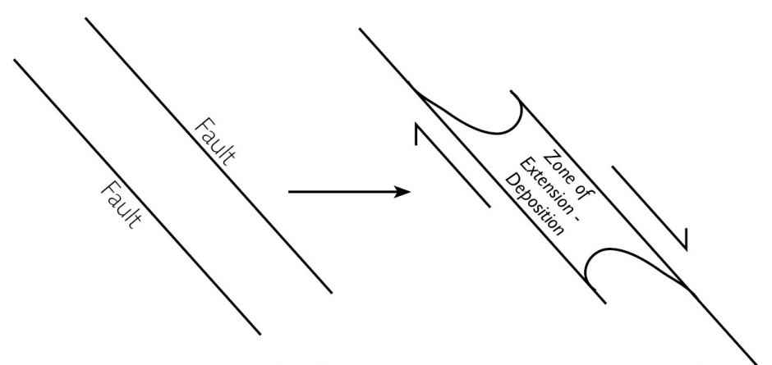
The alluvial valleys are pull-apart basins formed by differential movement along parallel faults creating a depression. The depression widens and deepens over time and fills with gravel, boulders and cobble eroded from the surrounding mountains.

Slide 9
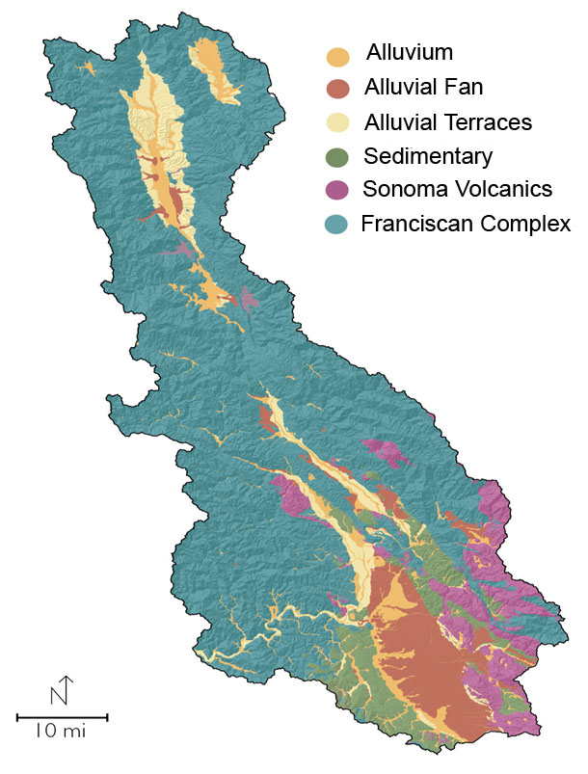
The basement rock of the watershed is Franciscan Complex, a jumbled mélange of rock types highly prone to erosion and landslides.
Franciscan Complex is low permeability; wells drilled in these rock types have low production rates of 1-10 gpm.
One of the other major rock types is the Sonoma Volcanics, deposited during a period of active volcanism 8 to 2.5 million years ago. Wells in this formation can be highly productive in the 100 gpm range.

Slide 10
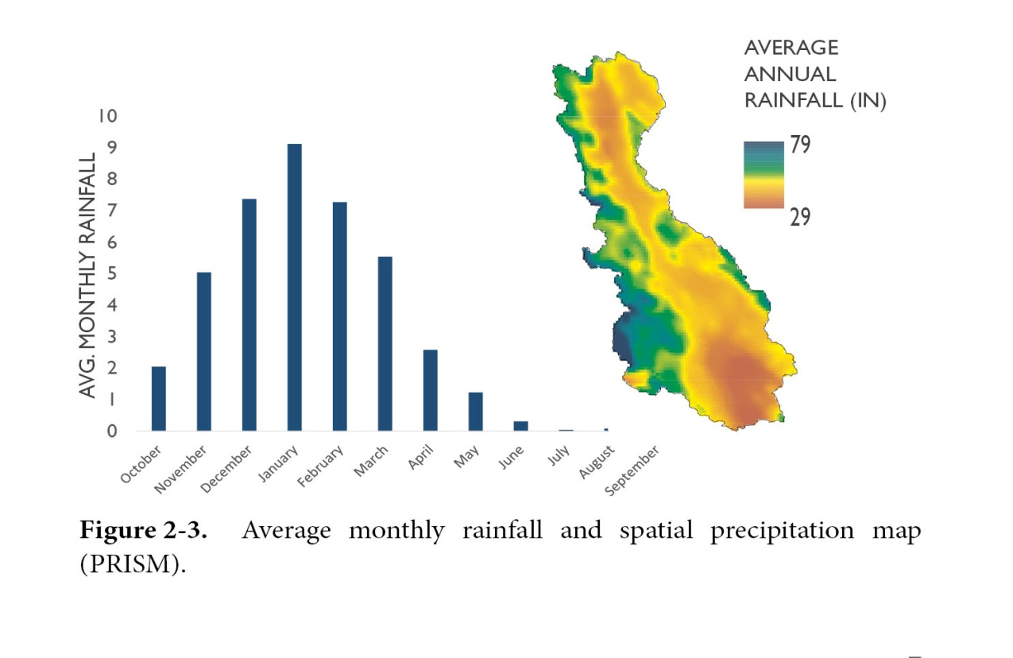
Mediterranean Climate
Average annual rainfall for the entire watershed is 42 inches, varies greatly with topography.
Coastal mountains have annual rainfall totals as high as 80 inches, whereas southern portions of the watershed have only 22 inches per year.
Dry season stream flow comes from groundwater storage

Slide 11
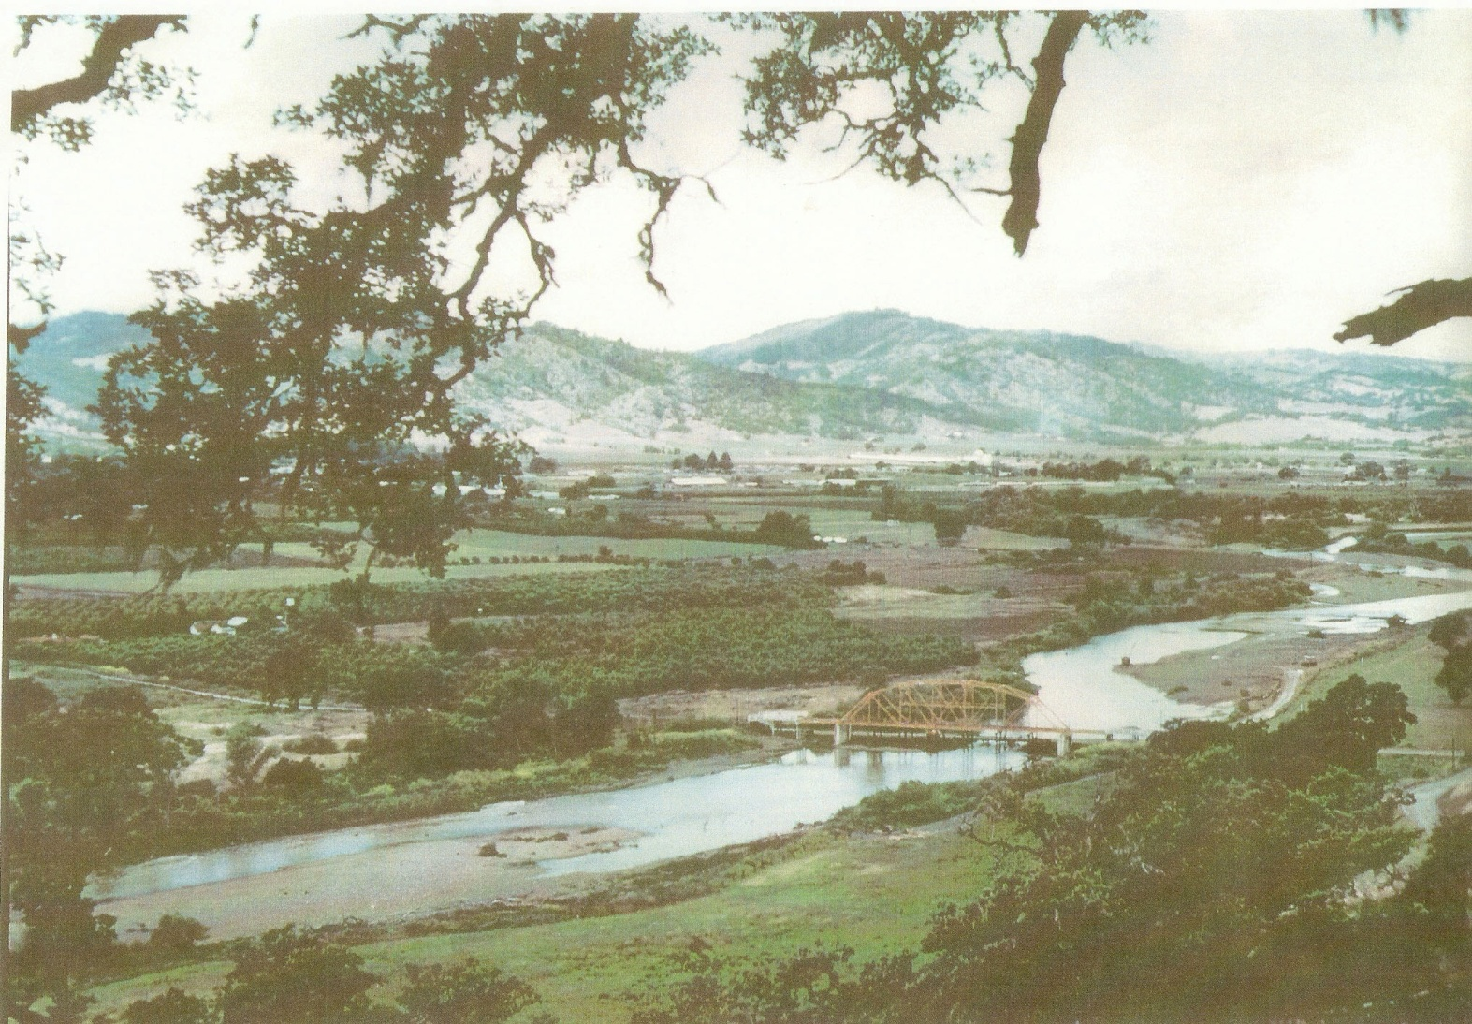
Historical Condition
Historical photograph of the Perkins St. Bridge over the Russian River in Ukiah Valley. Note wide shallow channel (Early 20th Century)

Slide 12
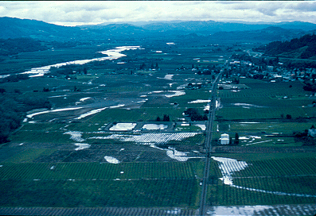
Post-flood view of Russian River shows old channels in floodplain

Slide 13
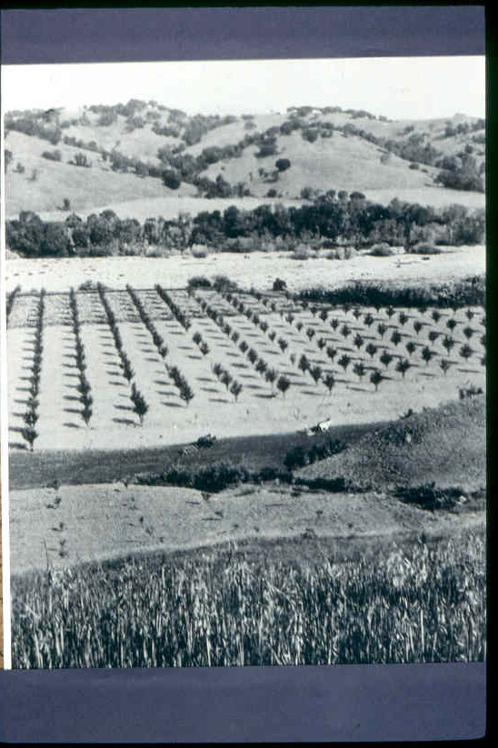
An 1851 journal from the expedition of Colonel Redick M’Kee, a U.S. Indian Agent, observed the West Fork of the Russian River on August 24-25 as “a completely dry channel”.
The river in Ukiah Valley is described as “Above here the river during the dry season runs chiefly under the sand and gravel only to be obtained in occasional pools”
Rainfall records in San Francisco for 1851 show a very dry year.
Early agriculture in Alexander Valley. Note horse-drawn plow and wide river channel in background.

Slide 14
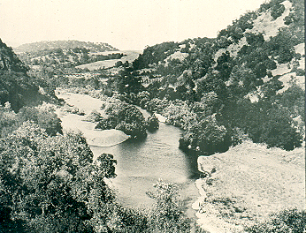
swimmers

Slide 15
Compilation of Illustrative Historical Low Water Measurements on Russian River Waterways
Waterway | Year | Discharge In cubic feet/second
East Fork Russian River | September 1905 | 2.2 cfs
West Fork Russian River | September 1905 | 1.2 cfs
West Fork Russian River | August 1911 | 0.5 cfs
Ackerman Creek – Ukiah Valley | September 2, 1911 | Dry at confluence with river
Orr Creek – Ukiah Valley | September 2, 1911 | Dry at confluence with river
Dry Creek | 1939 | Dry October 1 to December 8
Dry Creek | October 1941 October 1942 | 2.3 cfs 3.7 cfs
Upper Dry Creek | Sept. 14-24, 30, Oct. 1-6 1944 and Sept 24-Oct. 18 1949 | 0.1 cfs

Slide 16
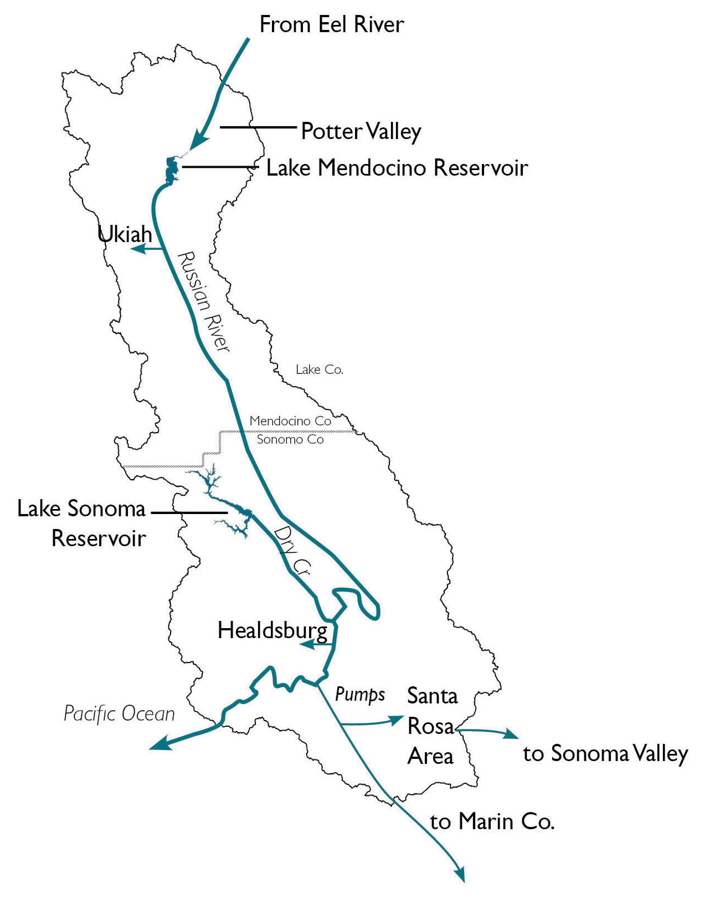
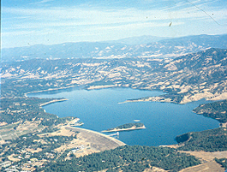
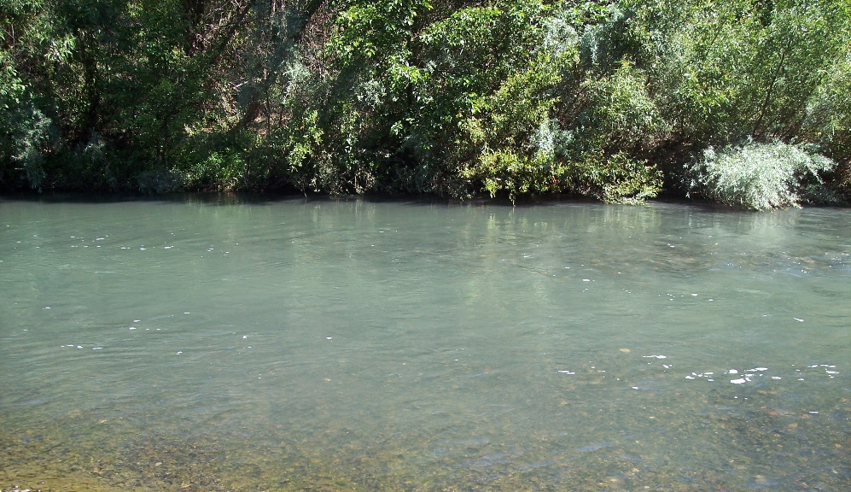
The Potter Valley Project was constructed in 1908 and Lake Pillsbury was constructed in 1922. Coyote Dam was constructed in 1959. Releases from Lake Mendocino provide summer flows significantly changing the hydrology of the Russian River

Slide 17
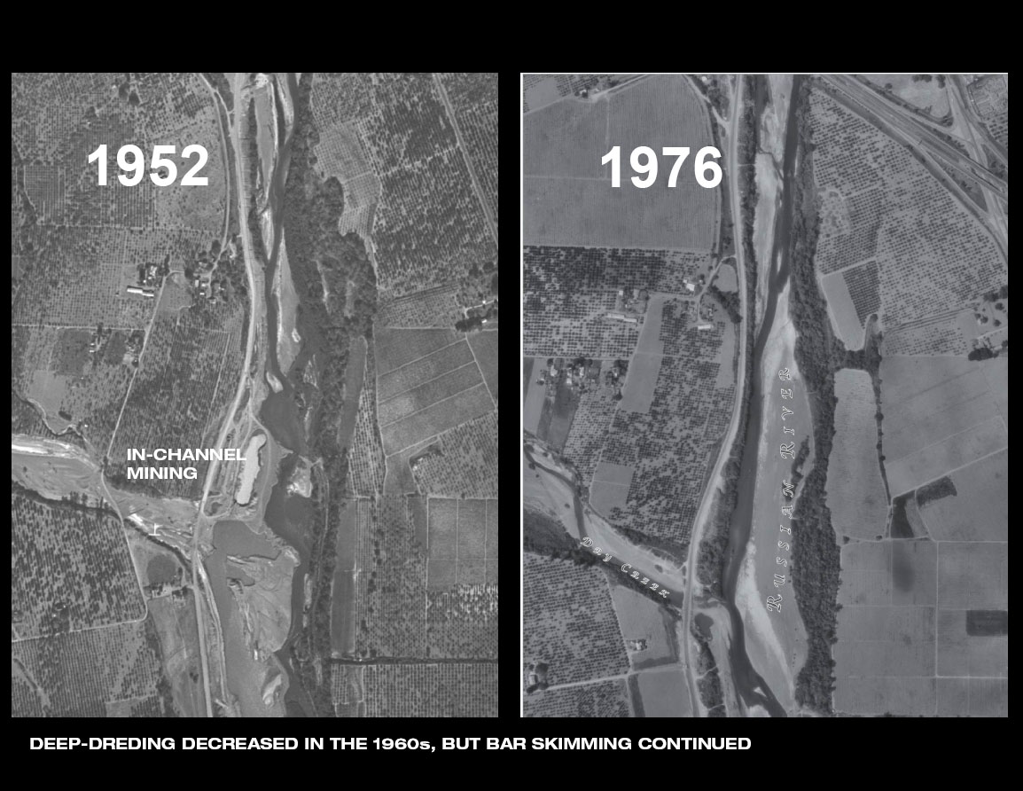
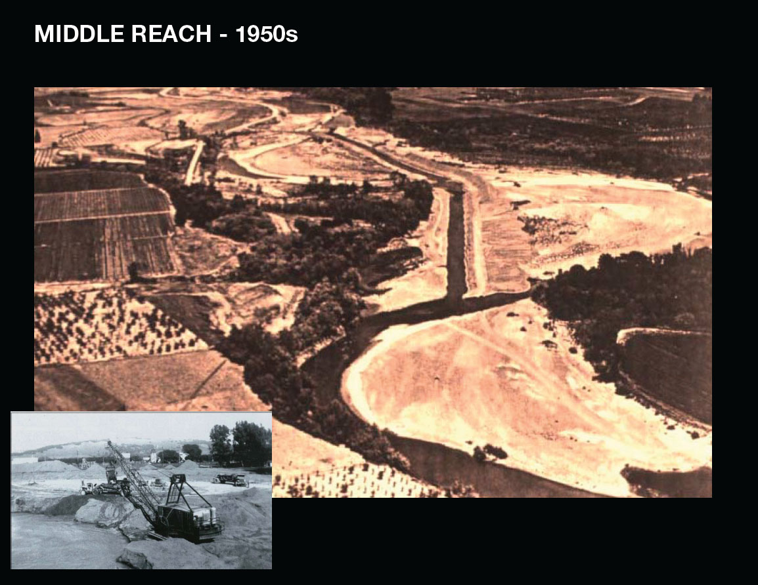
Gravel pit mining of the Russian River valley lowered the river bed by 20-50 ft. In 1981-90, 10 million tons of gravel were extracted from the river channel. Instream bar skimming and excavation of floodplain pits continues to be done. The Russian River continues to adjust to these major impacts.

Slide 18
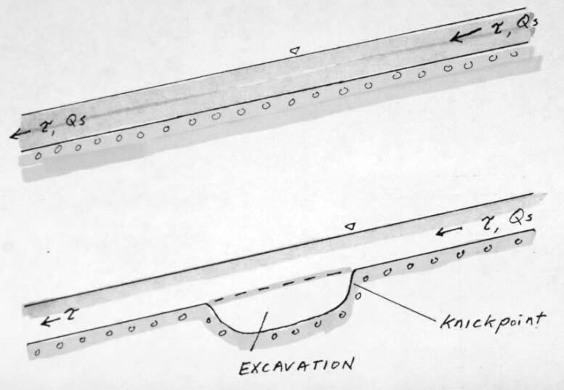
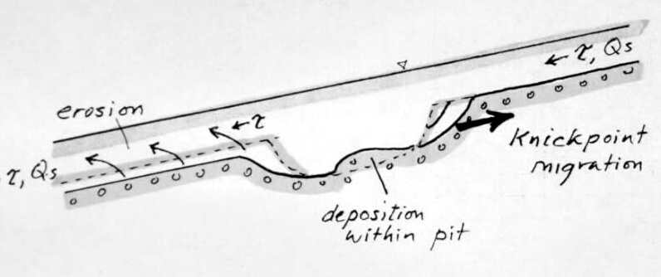
Effect of instream
gravel mining:
Incision upstream
due to headcutting, and downstream due to sediment starvation

Slide 19
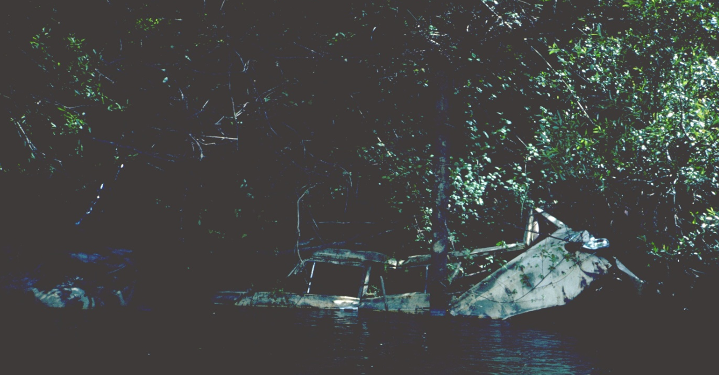
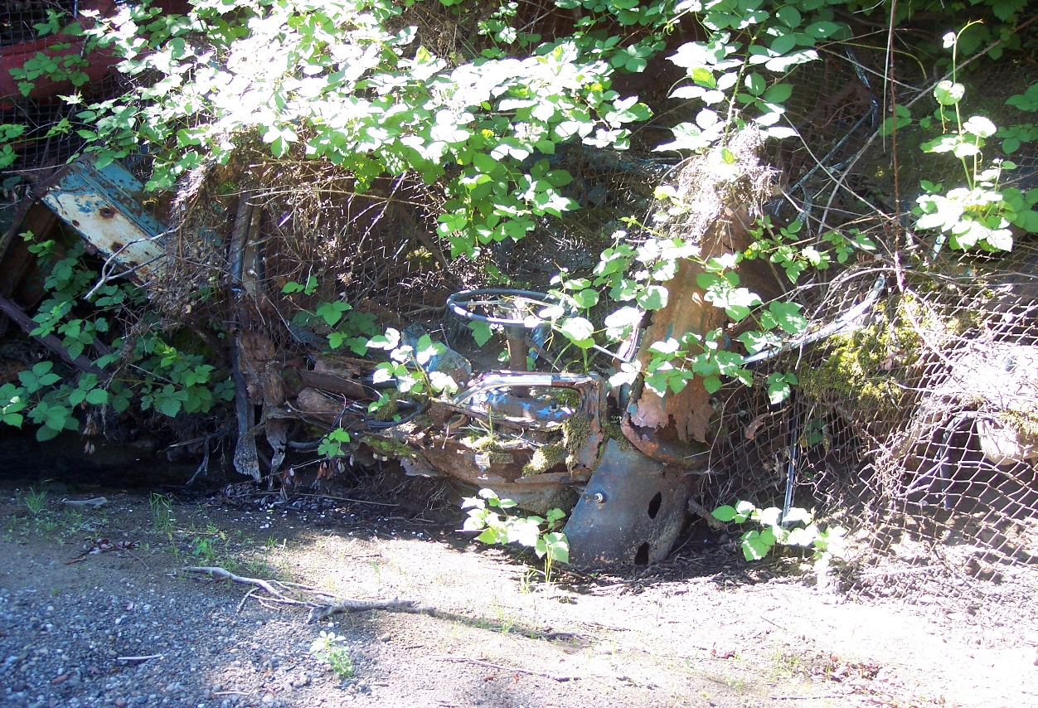
The use of car bodies to stabilize stream banks was recommended by the U.S. Dept. of Agriculture

Slide 20
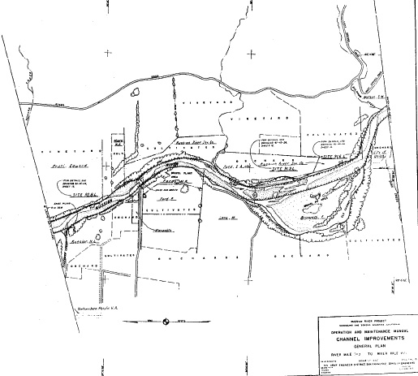
Army Corps of Engineers
Russian River Channel Improvement Project
Ukiah Valley

Slide 21
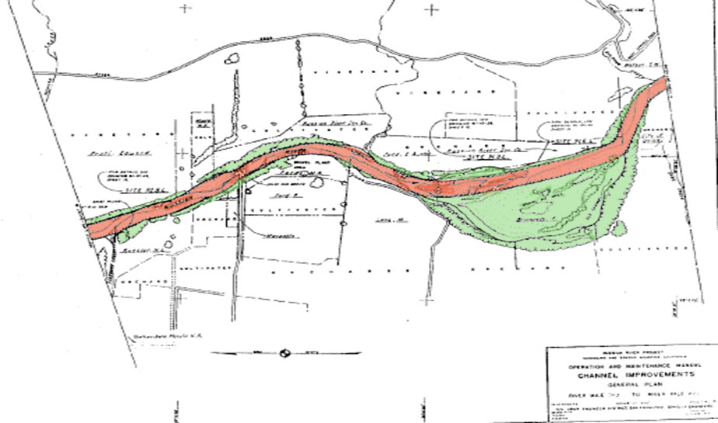

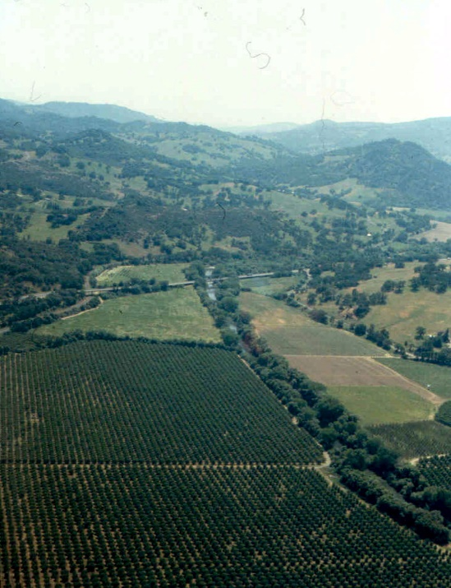
Army Corps of Engineers Russian River Channel Improvement Project in Ukiah Valley 1956-1963
Over the Ukiah-Hopland-Alexander Valley areas of the Russian River, the Corps’ project resulted in:
635 acres of channel clearing
210,000 cubic yards of channel excavation
10.8 miles of jacklines
4.4 miles of flexible fence
2.0 miles of willow planting with wire mesh (30 ft. wide strips)
11.3 miles of willow only planting (30 ft. wide strips)

Slide 22
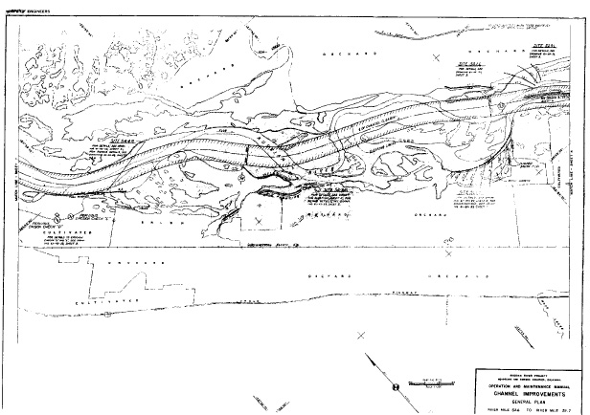
Army Corps of Engineers
Russian River Channel Improvement Project
in the Alexander Valley

Slide 23
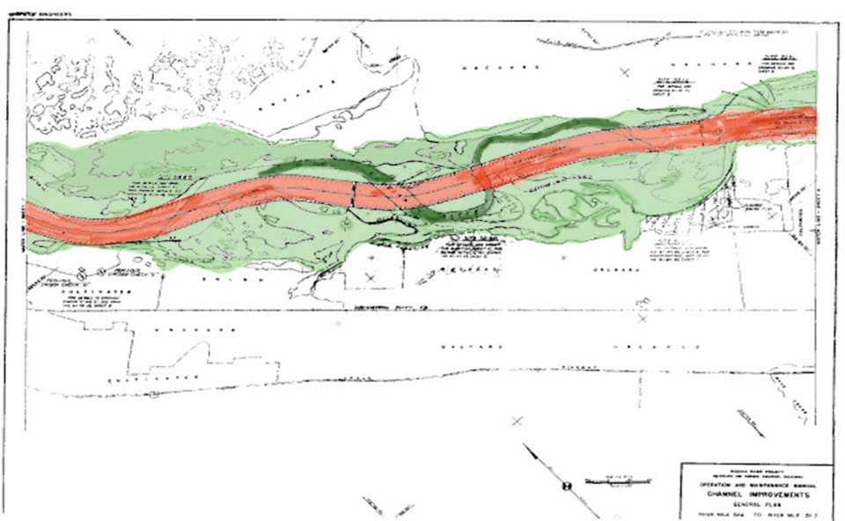
Army Corps of Engineers Russian River Channel Improvement Project in Alexander Valley

Slide 24
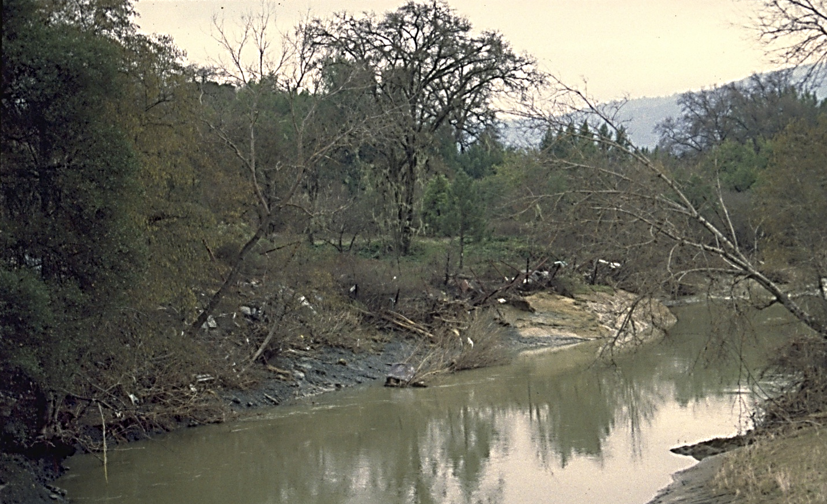
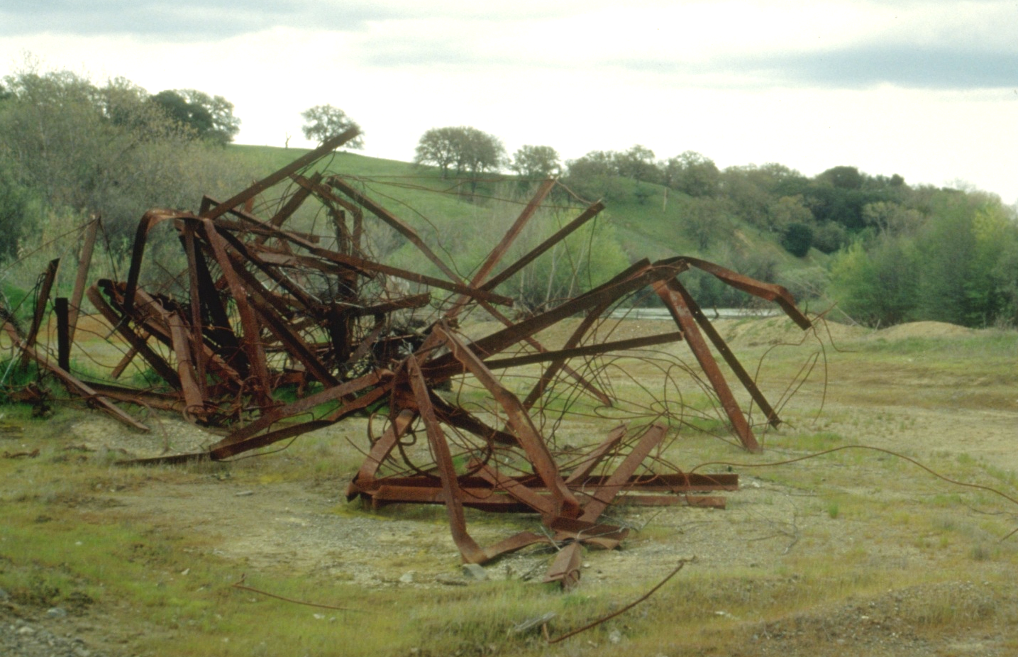
Jacklines installed as part of the Corps channel improvement project in the 1960s to protect banks have become debris in the river in some locations

Slide 25
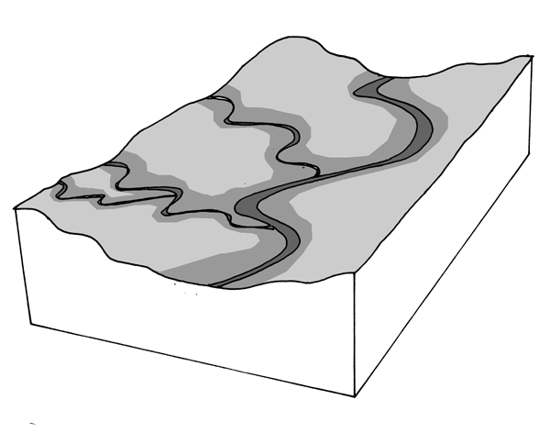
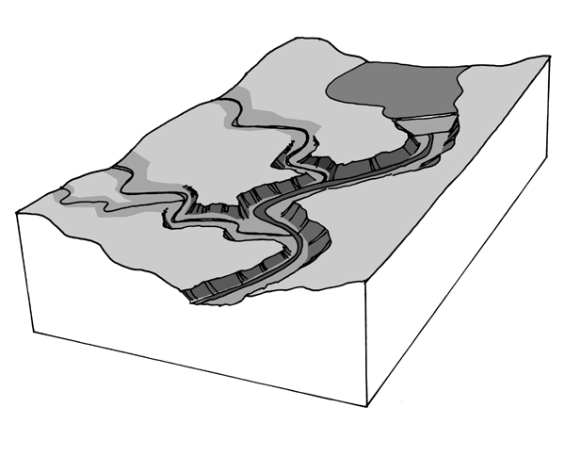
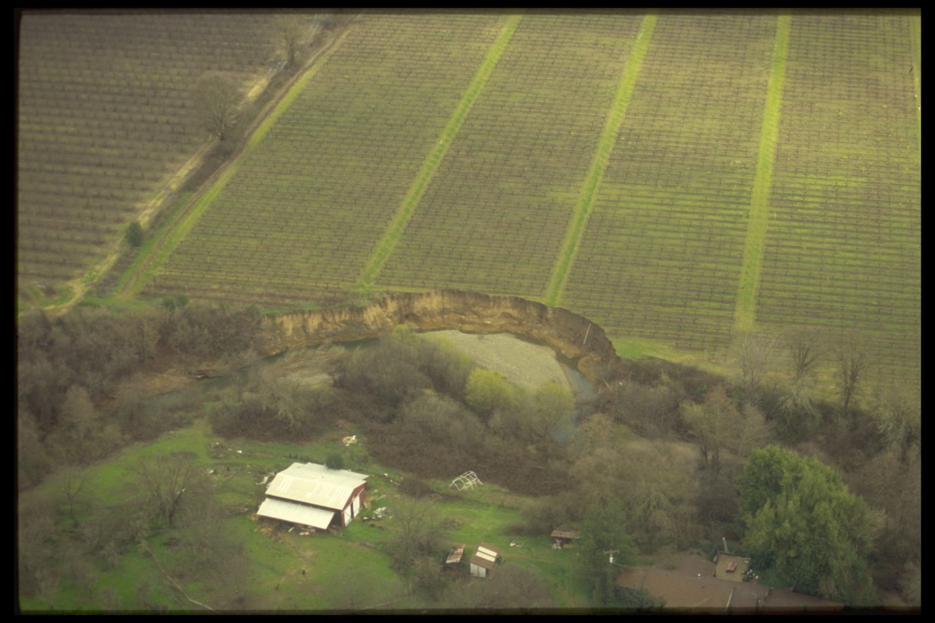
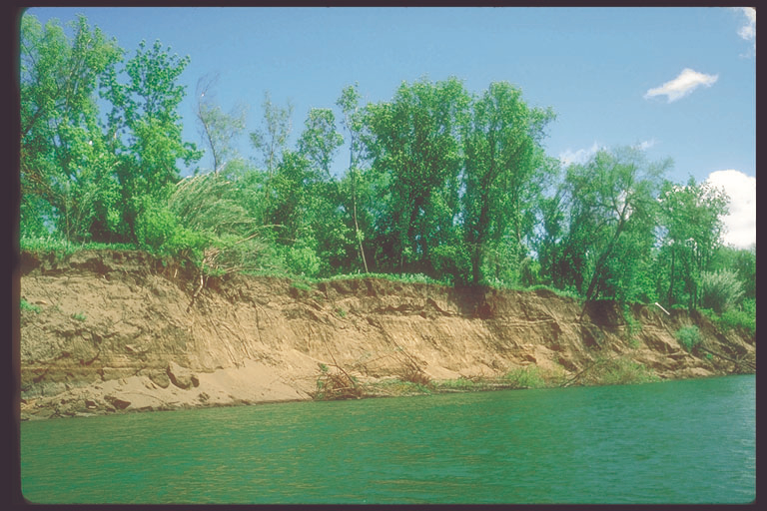
Russian River and tributaries before and after the construction of Coyote Dam. The reservoir impounds bedload releasing “hungry water” that erodes the bed and banks of the river
Incision in the Russian River in Ukiah and Hopland Valleys

Slide 26
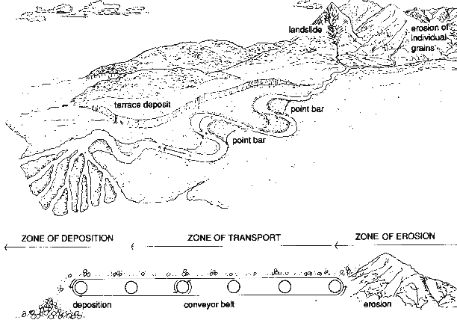
Longitudinal Continuity of Sediment Transport
Rivers carry not only water, but also sediment
- an essential component, responsible for channel form
The transport zone is like a conveyor belt:
on geological time scale the sediment is in motion,
with only temporary storage in bars, floodplains, etc..
Dams interrupt this natural continuity of sediment flux.

Slide 27
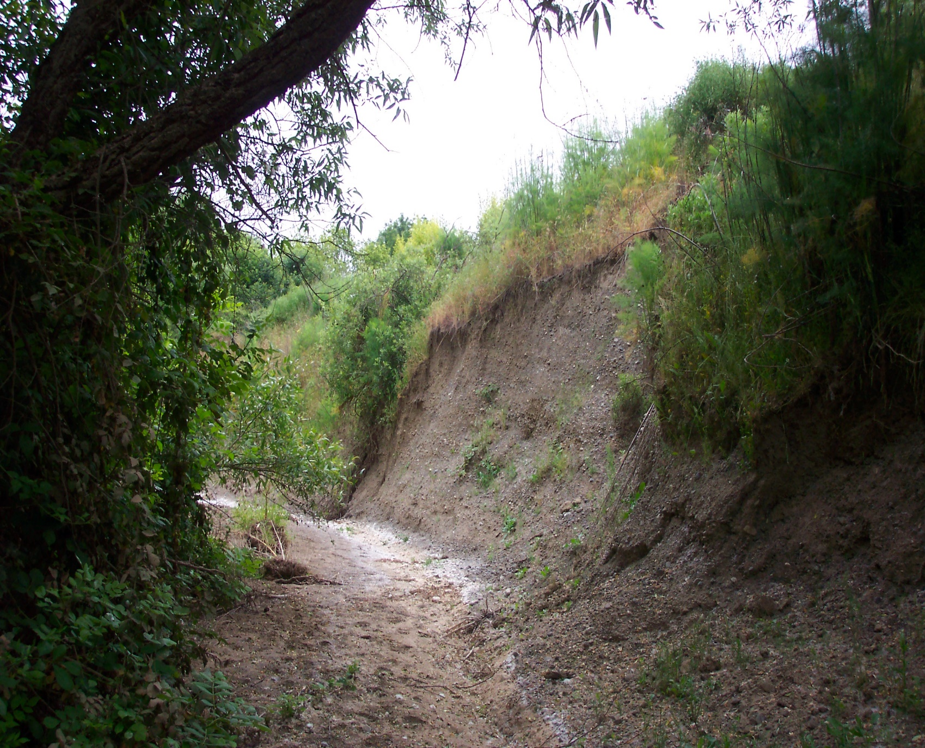
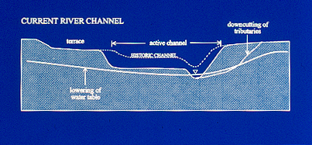
Entrenchment of the Russian River in its alluvial valleys migrates up tributary streams eroding out aquatic and riparian habitats

Slide 28
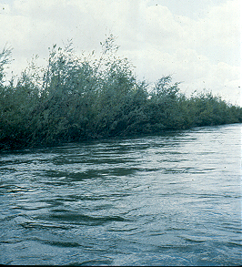
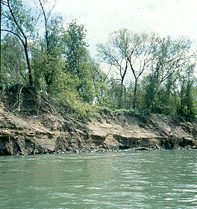
Flood releases from Coyote Dam following a major storm can cause bank erosion. The effects of flood releases on the geomorphology of the Russian River channel have not been studied adequately.

Slide 29
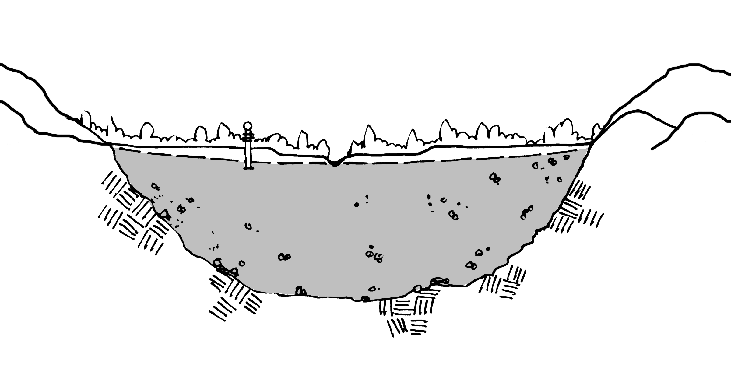
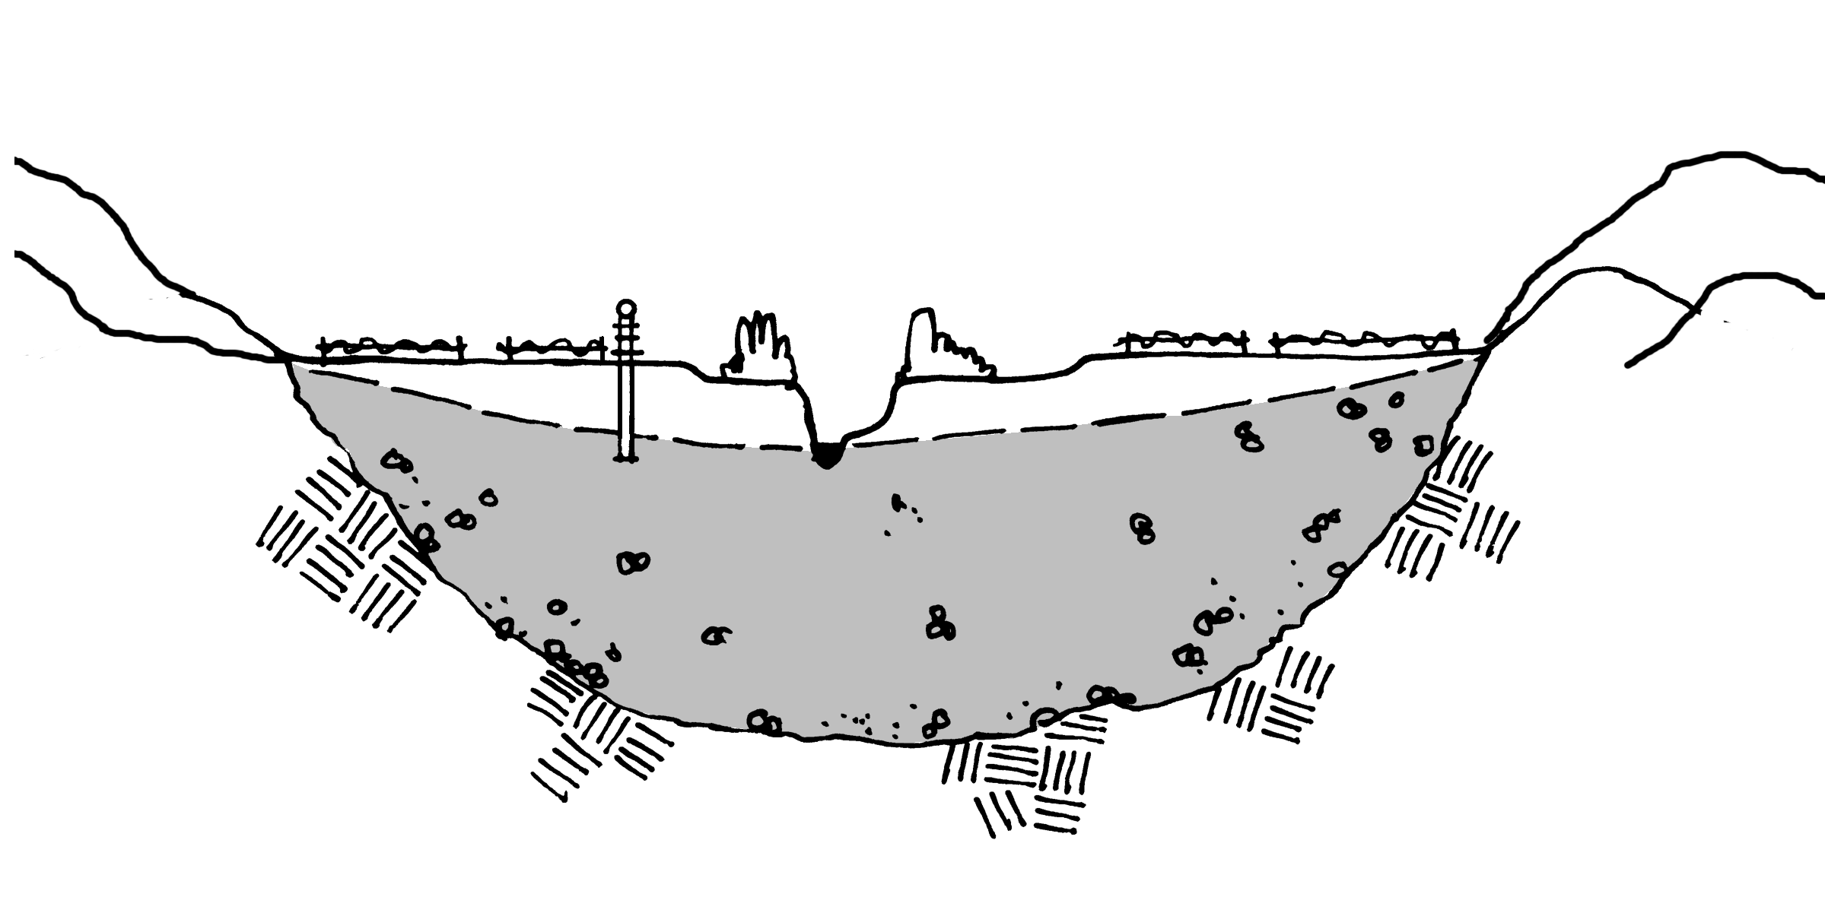
Incision of the main stem river channel lowers the groundwater table in the alluvial aquifer.
This process has occurred in rivers and groundwater aquifers worldwide including: the Apalachicola River in Florida, the Mojave River in Ca., waterways in the Tar River Basins in North Carolina, Goulburn River in Australia, Drôme River in France and the Mendenhall River in Alaska.

Slide 30
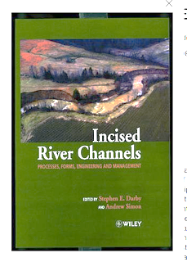

Slide 31
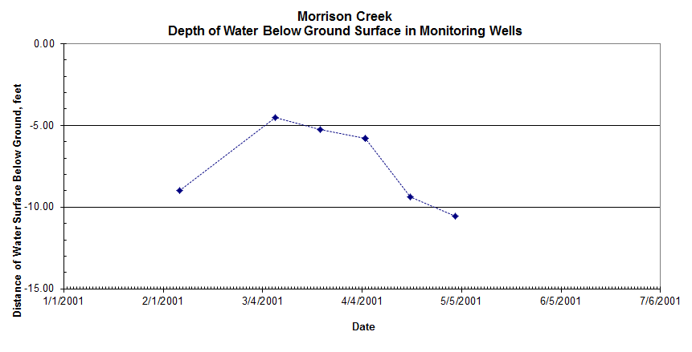
The drop in groundwater level in Morrison Creek coincides with the drop in flow levels in the main river channel. This same pattern was measured in Parsons Creek
No juvenile steelhead could have migrated out of these creeks in March.
Ground surface

Slide 32
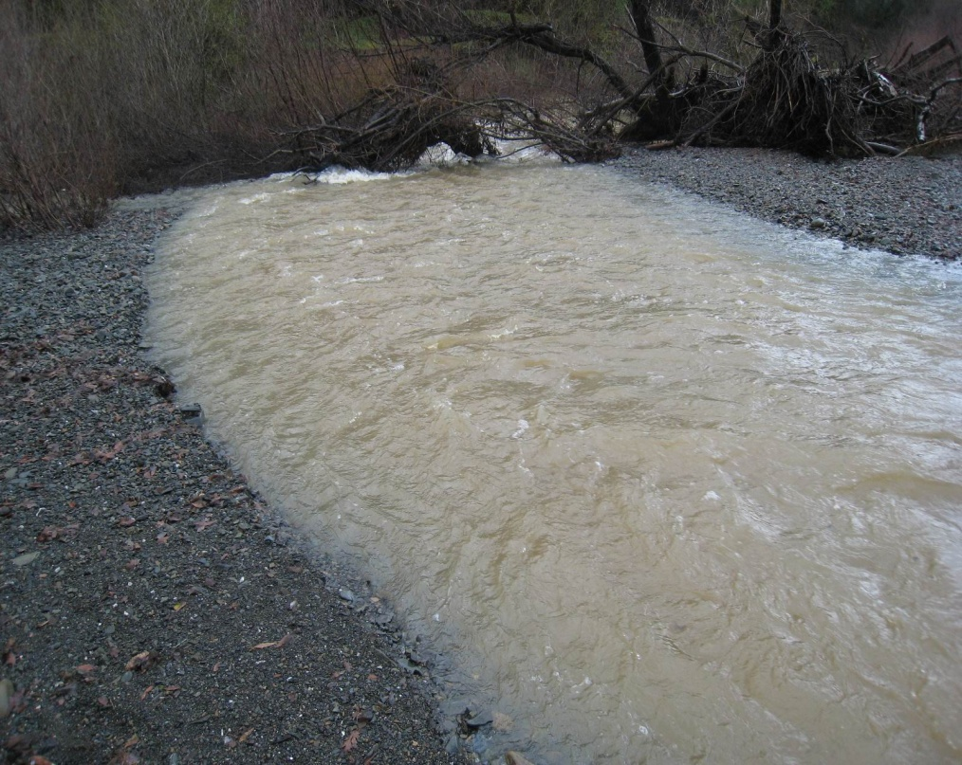
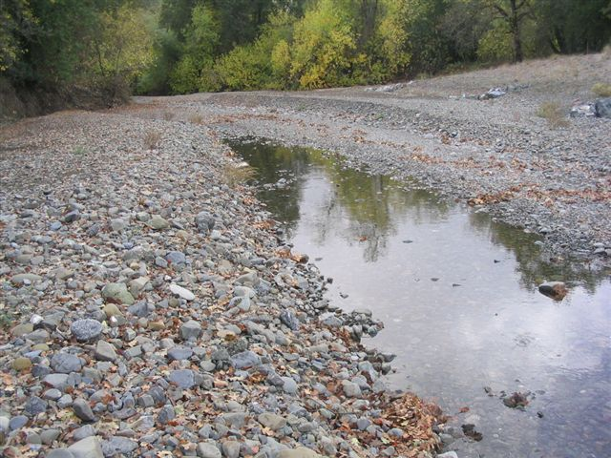
Morrison Creek flows to the Russian River channel when river stage is high but when river stage is low creek goes subterranean prior to reaching river

Slide 33
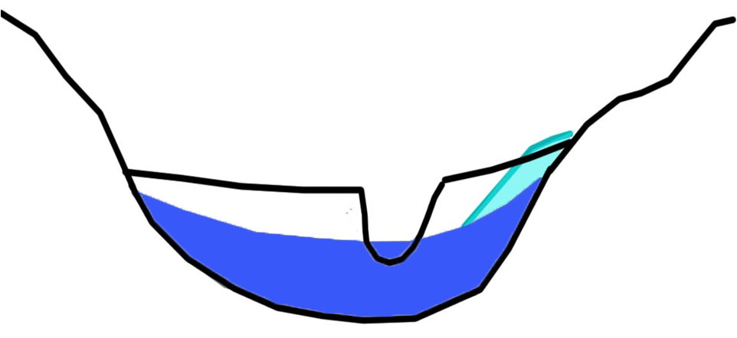
MOUNTAINS
LOW RIVER FLOW
MOUNTAINS
Steep slope = faster percolation
ENTRENCHED RIVER CHANNEL
DURING AND AFTER RAINSTORM-
CREEK EXITING MOUNTAINS AND CROSSING ALLUVIAL VALLEY
ALLUVIAL BASIN WITH GROUNDWATER
At low flow in the river channel, water exiting the creek canyon onto the alluvial valley will percolate into the alluvium until the alluvium is filled with water and the river rises.
The slope of the groundwater basin between the creek outlet and the river level determines how quickly the water percolates.
This situation can strand steelhead.

Slide 34
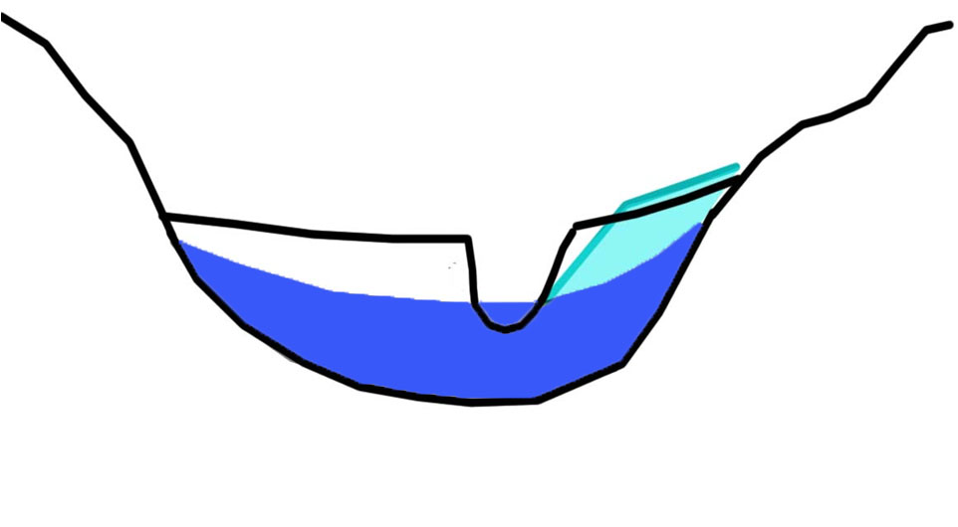
LOW RIVER FLOW
MOUNTAINS
MOUNTAINS
ENTRENCHED RIVER CHANNEL
DURING AND AFTER RAINSTORM-
CREEK EXITING MOUNTAINS AND CROSSING ALLUVIAL VALLEY
ALLUVIAL BASIN WITH GROUNDWATER
During large or intense rainfall events when the river is still low creek flow may be great enough to make it nearly to the river channel before percolating into the alluvium.
This situation can strand out migrating steelhead.

Slide 35
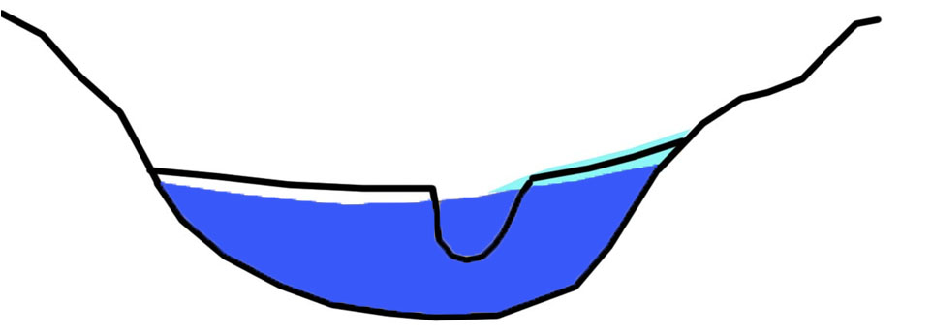
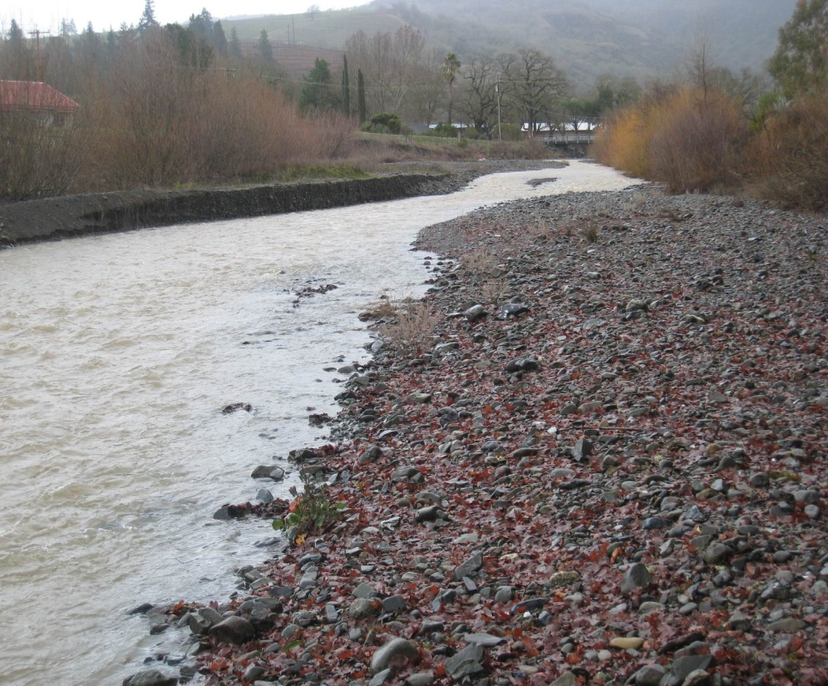
MOUNTAINS
HIGH RIVER FLOW
MOUNTAINS
ENTRENCHED RIVER CHANNEL
DURING AND AFTER RAINSTORM-
CREEK EXITING MOUNTAINS AND CROSSING ALLUVIAL VALLEY
ALLUVIAL BASIN WITH GROUNDWATER
MORRISON CREEK AT HIGH FLOW IN FEBRUARY 2009 – CONNECTED FLOW

Slide 36
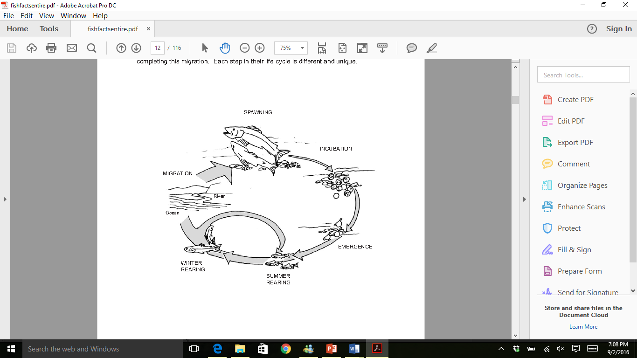
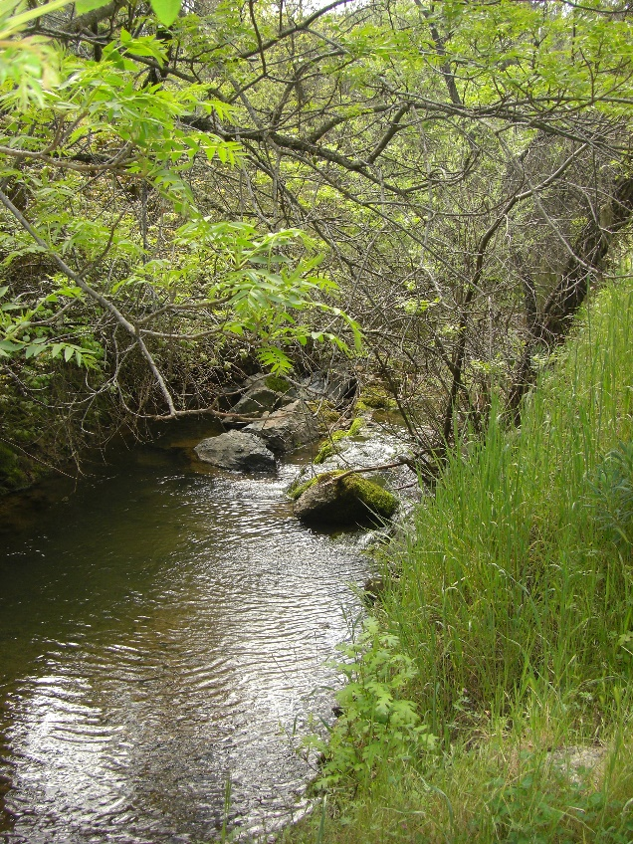


Coho salmon and steelhead trout rear in tributaries in the summer. In the dry warm summer, groundwater provides the cold water in creeks that salmonids require. Many creeks are naturally summer dry, while others maintain flow.
Rearing steelhead in summer groundwater-fed pool

Slide 37




Channelization
On-stream dams
Tributaries in the Russian River are affected by channelization, urbanization, on-stream dams, direct water diversions and channel incision
Direct water diversions
Urbanization

Slide 38
Ongoing Efforts to Restore the System
Biological Opinion (BO) for Water Supply, Flood Control and Channel Maintenance required reductions of dry season releases from Coyote Dam, studies of the effects of flood season releases on the erosion of the Russian River channel, restoration of habitats on Dry Creek.
Endangered Species Recovery Plans. A recovery plan for Coho salmon was released in 2012. A recovery plan for Chinook salmon and steelhead trout was released in November 2015.
Russian River Coho Salmon Captive Broodstock Program. This program raises Coho salmon for release into the wild. PIT (passive integrated transponders) are placed in a percentage of the Coho for tracking fish movements.
California Department of Fish and Wildlife (CDFW) administers the Fisheries Restoration Grant Program and a number of regulatory programs.
Sonoma County Water Agency (SCWA) is leading the effort outlined in the BO to restore salmonid habitats on six miles of Dry Creek.
A number of organizations implement restoration projects including Russian Riverkeeper, Trout Unlimited, Resource Conservation Districts, and the California Land Stewardship Institute (Fish Friendly Farming Program).
Agricultural Water Enhancement Program. a project of the Natural Resource Conservation Service (NRCS) and the California Land Stewardship Institute, worked with grapegrowers to construct over $7.5 million in off-stream ponds to reduce direct diversions for frost control.
Russian River Habitat Blueprint. The National Oceanic Atmospheric Administration (NOAA) selected the Russian River as a Habitat Focus Area.

Slide 39

SURFACE AND GROUNDWATER INTERACTIONS

Slide 40
Groundwater studies have been completed in several of the large alluvial valleys:
Ukiah Valley
Alexander Valley
Santa Rosa Plain
The groundwater level data available for these areas was collected after the major episodes of channel incision in the Russian River and therefore the data do not show pre and post incision groundwater levels

Slide 42

Groundwater recharge processes. Runoff from adjacent hills and tributary creeks are the primary source of groundwater recharge

Slide 43

Ukiah Valley subarea major groundwater basin coincides with alluvial deposits

Slide 44


CROSS SECTION OF UKIAH VALLEY
Note Recent (Holocene) alluvium on surface and Continental Basin deposits at depth. Recent alluvium has highest production wells

Slide 45


43
96
200
250
400
36
95
200
40
63
62
625
Well drilling logs show subsurface features of Ukiah Valley groundwater basin
441

Slide 46




Ukiah Valley groundwater level measurements ( post river channel incision) show no long-term declines but there is a lack of continuous groundwater monitoring

Slide 47
Groundwater Basin | Areal Extent | Depth of Deposit | Groundwater Well Production gallons per minute (gpm) | Groundwater Storage Capacity | Status of Groundwater Level
Redwood and Ukiah Valleys | 59 sq. miles | Alluvium -50-80 ft.; Continental deposits 200 ft. | Alluvium 50-1200 gpm | Alluvium, terrace, river channel deposits, continental deposits: 324,000 ac-ft.; alluvium and terrace deposits only: 75-100,000 ac-ft., river channel deposits only 35,000 ac-ft. | Stable
Hopland Valley | 8.4 sq. miles | Alluvium un- to semi confined - 50 ft.; Continental deposits - 2000 ft. | Alluvium 500 gpm; Continental deposits 1-50 gpm | Alluvium 20,000 ac-ft. | Stable
McDowell valley | 2 sq. miles | Alluvium 200 ft.; Continental deposits - 2000 ft. | Alluvium 500 gpm; Continental deposits 1-50 gpm | Not available | Stable
From: California Department of Water Resources, 2004. California’s Groundwater: North Coast Hydrologic Region Bulletin 118.

Slide 48




Alexander Valley groundwater basin
20-100 ft. of recent alluvium overlying dense Franciscan Complex
50-100 ft. of recent alluvium overlying older alluvium. Basement rock is Great Valley Sequence with Sonoma Volcanics on eastern margin
150-350 ft. of recent alluvium overlying Franciscan Complex

Slide 49




Alexander Valley groundwater monitoring shows small change in groundwater levels but study notes small data set and lack of continuous monitoring. Data are post incision of the Russian River.

Slide 50


Slide 51

Santa Rosa Plain groundwater basin. Studies show some over extraction in deep aquifer

Slide 52


Slide 53


